Slide 1

National Institute of Technology Karnataka,Surathkal
Mangalore,Karnataka 575025
Department of Civil Engineering
Mini Project on
DESIGN AND ANALYSIS OF CABLE STAYED BRIDGES
Presented By:
P GEETHA (231CV238)
KEERTHIPRABA (231CV225)
SRUSHTI D S (231CV254)
BHUMIKA MEENA (231CV213)
Under the guidance of,
Dr. PRASHANTH M H

Slide 2
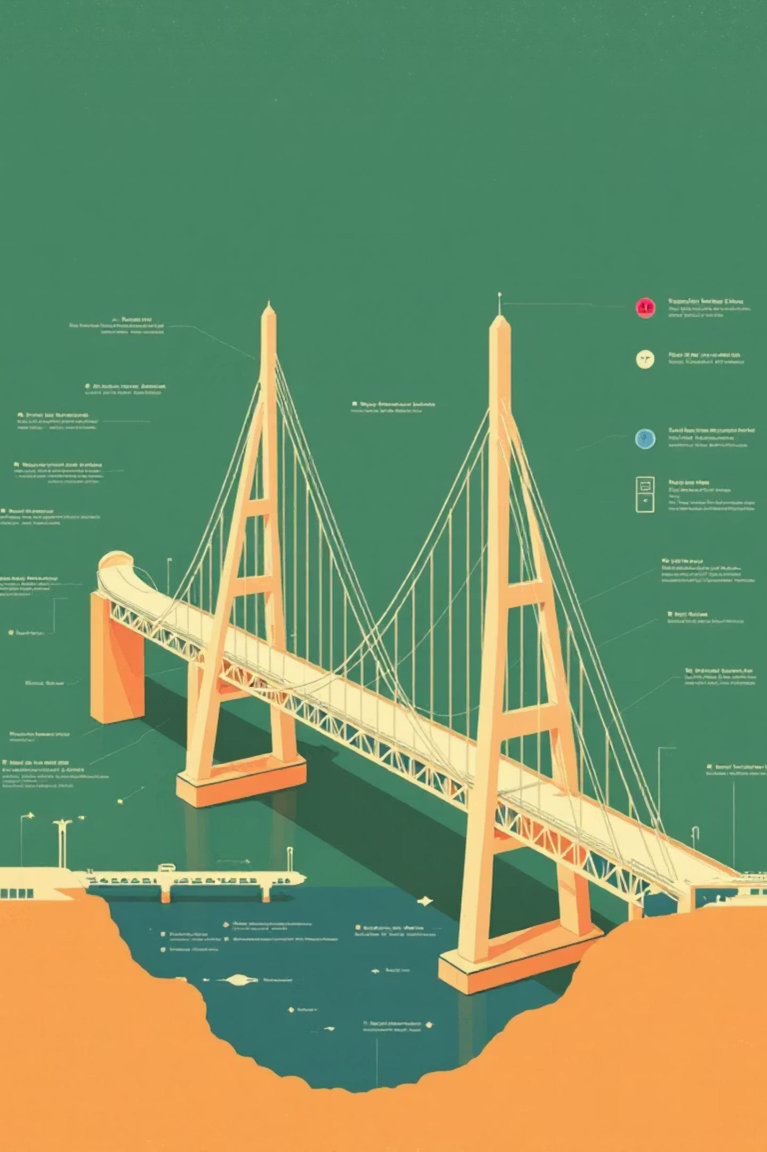
Understanding Bridge Anatomy: Superstructure and Substructure
Bridges are structurally divided into two main components: the superstructure, which carries traffic loads, and the substructure, which supports the superstructure and transfers loads to the ground.
Superstructure
1
The visible part of the bridge above the supports, including the deck, girders, trusses, and cables, designed to carry vehicular and pedestrian traffic.
Substructure
2
The hidden part beneath the deck, comprising abutments, piers, columns, footings, and foundations, responsible for transferring loads safely into the earth.
Load Transfer System
3
Describes how loads flow from the superstructure, through the substructure, and ultimately into the foundation and the ground.

Slide 3


Bridges: Essential Lifelines for Connectivity
Bridges are critical infrastructure, overcoming geographical barriers and facilitating efficient movement of people and goods. They significantly reduce travel time and distance, driving economic and social progress.
Connectivity & Convenience
Economic & Social Benefits
Links separated locations, enabling travel over obstacles.
Supports trade and economic growth by facilitating movement of goods.
Saves time and distance by providing direct routes.
Improves accessibility to essential services, jobs, and opportunities.
Crucial for developing modern transportation systems.
Fosters cultural exchange by connecting communities.

Slide 4
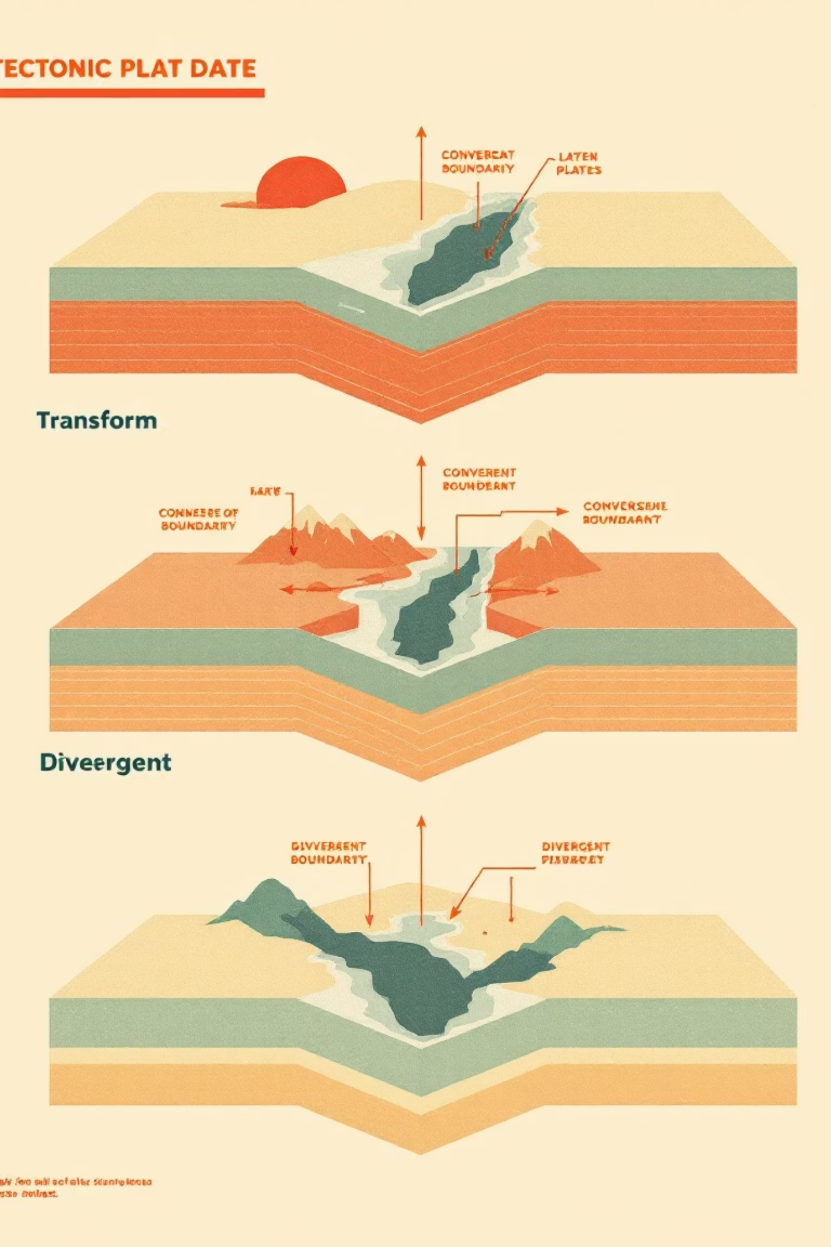
The Genesis of Earthquakes: Tectonic Plate Interaction
Earthquakes are caused by the sudden release of energy stored along tectonic plate boundaries, resulting in ground shaking as seismic waves propagate.
1
Plate Movements & Stress
Stress builds along plate boundaries, leading to sudden ruptures or slips when exceeding rock strength, a primary concern for structural stability.
2
Transform Boundaries
Plates slide past each other horizontally, exemplified by the San Andreas Fault, generating significant seismic activity that engineers must account for.
3
Convergent Boundaries
Plates collide, resulting in powerful earthquakes as one plate subducts or both uplift, posing major challenges for resilient infrastructure design.

Slide 5

DESIGN AND ANALYSIS OF CABLE STAYED BRIDGES
OBJECTIVE
This study advances cable-supported bridge engineering by integrating material analysis (steel, CFRP, BFRP, GFRP, AFRP) with STAAD.Pro methodology. It explores structural responses to seismic and wind loads, emphasizing a performance-based design approach for enhanced resilience.

Slide 6
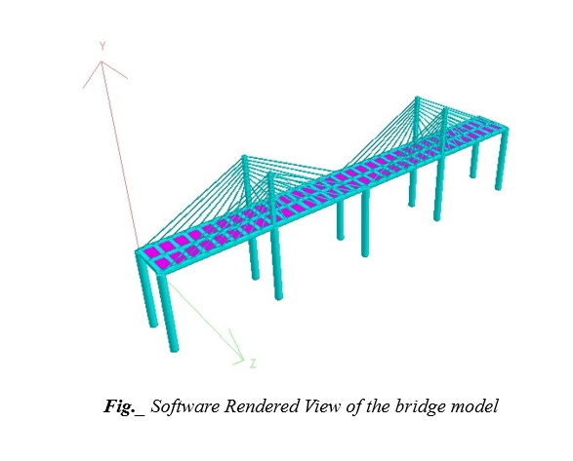
Methods & Methodology
STAAD.Pro Analysis of a Cable-Stayed Bridge
A cable-stayed bridge model was analysed using STAAD.Pro Connect Edition, focusing on structural behaviour under various loads and material properties.
Bridge Specifications
Main Span: 64 meters
Deck: 64m x 6m, 0.135m thick, M30 concrete.
Pylons: 4 reinforced concrete, 8.5m above deck.
Stay Cables: 64 tension-only, 0.089m diameter, fan-type arrangement.
Piers: 10 concrete, 12m high, 1.0m diameter, fixed supports.
Support Conditions: Fixed at base, allowing thermal expansion
Analysis Type: Linear static and dynamic modal analysis

Slide 7
Literature Review: Different Cable Materials
Evolution of Cable Materials in Bridge Engineering
The choice of cable material fundamentally affects structural efficiency, durability, and safety, driving a continuous evolution from early wrought iron to modern fibre-reinforced polymers (FRP).
High-Strength Steel
1
Global standard for high tensile capacity, predictable properties, and economic feasibility; susceptible to corrosion and fatigue.
2
FRP Composites
CFRP, AFRP, and GFRP offer high strength-to-weight ratios and corrosion resistance, but pose challenges in anchorage and long-term behavior.
Hybrid Systems
3
Combine steel and FRP to optimize ductility, corrosion resistance, and cost for balanced performance.
4
Future Materials
Emerging materials like ultra-high performance concrete cables or advanced nanocomposites are being researched.

Slide 8
Comparative Material Properties for Cable Systems: Part 1 - Steel and Carbon/Basalt FRP
Detailed material properties, including Young's Modulus, Poisson's Ratio, Density, Thermal Coefficient, and Shear Modulus, are crucial for accurate structural analysis in STAAD.Pro. This table focuses on traditional Steel and advanced Carbon Fiber Reinforced Polymer (CFRP) and Basalt Fiber Reinforced Polymer (BFRP) materials.
Material
Young's Modulus
Poisson's Ratio
Density
Thermal Coeff.
Shear Modulus
Steel
1.99947e+08
0.3
76.8191
6.5e-06
7.7221e+07
CFRP
1.45e+08
0.28
15.7
2e-06
5.66e+07
BFRP
8.5e+07
0.28
26
4.44e-06
3.3465e+07

Slide 9
Comparative Material Properties for Cable Systems (Part 2: Glass/Aramid FRP and Steel Tendon)
This table concludes the detailed material properties essential for comprehensive structural analysis in STAAD.Pro, focusing on Glass Fiber Reinforced Polymer (GFRP), Aramid Fiber Reinforced Polymer (AFRP), and Steel Tendon materials.
Material
Young's Modulus
Poisson's Ratio
Density
Thermal Coeff.
Shear Modulus
GFRP
4e+07
0.28
19.62
1e-05
1.5556e+07
AFRP
7e+07
0.3
13.734
2.78e-06
2.6923e+07
Steel Tendon
2e+08
0.3
77.005
6.67e-06
7.6923e+07

Slide 10

Results and Discussions

Slide 11
Comparison of Displacement for Different Materials
Vehicle Loads
Static Loads
Steel and steel tendons record the highest relative displacements, while CFRP and AFRP show the lowest, indicating superior stiffness and seismic stability.BFRP and GFRP perform moderately, proving that lighter FRP cables effectively control movements and enhance overall dynamic response.
Combined Loads

Slide 12
Beam Results (Max Axial.Shear and BM)
Steel and steel tendons generated the highest axial forces, shear forces, and bending moments, showing greater force transfer and higher demand on deck beams under combined loads.All FRP cable materials significantly reduced beam forces and moments, with CFRP and AFRP providing the most efficient load distribution and improved seismic response.Overall, FRP cables deliver a lighter, more balanced, and less force-intensive structural behaviour, enhancing beam performance under multi-hazard loading.

Slide 13
Support Reactions
Steel and steel tendons generated the highest support reactions, indicating larger force transfer and greater foundation demand under combined loads.All FRP materials showed significantly reduced reaction forces, with CFRP and AFRP delivering the most efficient load distribution.Overall, FRP cables improve seismic and wind performance by lowering base shear and overturning forces, making them structurally more efficient than steel..

Slide 14
Plate Centre Stresses
Steel cables generated the highest SX, SY, and SXY stresses, indicating greater force concentration on the deck under combined loads.All FRP materials produced significantly lower plate stresses, with CFRP and AFRP giving the most consistent reductions.Overall, FRP cables improve deck stress distribution and reduce peak stress demand, enhancing structural efficiency under full loading conditions.

Slide 15
CONCLUSIONS
Steel cables show the highest displacements, forces, reactions, and stresses, leading to increased structural demand and higher long-term maintenance costs.
FRP cables—especially CFRP and AFRP—deliver superior material efficiency, with lower displacements, smoother force transfer, reduced plate stresses, and improved seismic and wind performance.
CFRP and AFRP offer the best overall value, combining high structural efficiency with minimal maintenance and lowest lifecycle cost, while BFRP and GFRP provide moderate, budget-friendly alternatives.

Slide 16
References
Key Research Sources
Key academic references informing our understanding of seismic bridge design, advanced materials, and structural analysis techniques.
Kawashima, K. (2014). Seismic performance and design of cable-stayed bridges. Journal of Bridge Engineering, 19(5), 04014002.
Hollaway, L. C., & Head, P. R. (2016). Advanced Polymer Composites and Polymers in Civil Infrastructure. Woodhead Publishing.
Niu, H., Wu, Z., Yu, T., & Li, S. (2017). A review of recent advances in FRP composites for bridge engineering. Composites Part B: Engineering, 116, 269-281.
Al-Saadi, S. A., & Al-Mahaidi, R. S. (2018). Comparison of steel and FRP stay cables in cable-stayed bridges. Engineering Structures, 172, 701-715.
Priestley, M. J. N., Seible, F., & Calvi, G. M. (2007). Seismic Design and Retrofit of Bridges. John Wiley & Sons.
Tembhe, P. B., & Kulkarni, D. B. (2015). A study on seismic behavior of cable stayed bridge using STAAD.Pro. International Journal of Engineering Research and General Science, 3(2), 794-802.

Slide 17
THANK YOU

